Slide 1
Economy and Markets
07/03/2025
© Gilbert Ho, 2025. All Rights Reserved.

Slide 2
Legal Disclaimer And Risk Disclosure
These materials are for educational and entertainment purposes only and are neither a solicitation, nor an offer to buy or sell any financial instrument.
All information provided here is the personal opinion of the authors. The authors, AAII, AAII-Silicon Valley, AAII-SV-CI Group leaders and members, make no claim that the information in any of these presentations is correct. Under no circumstances should any of the information in these presentations be taken as personal or individual trading advice. Past performance and/or hypothetical results of any trading method are not indicative of future results. Trading and investing in any financial instrument carries high levels of risk and may not be suitable for all investors. You should be aware of all the risks associated with trading, and seek advice from a financial professional, if you have any doubts.
The authors, AAII, AAII-Silicon Valley, AAII-SV-CI Group leaders and members, will not assume any responsibility whatsoever for the actions of the reader nor financial losses that may result from the use or misuse of the information presented.
Economics and markets are not governed by physical laws of the universe.
Patterns in data only serve to weigh probability, they do NOT dictate the future.
Each slide has a theme and may contain multiple charts.

Slide 3
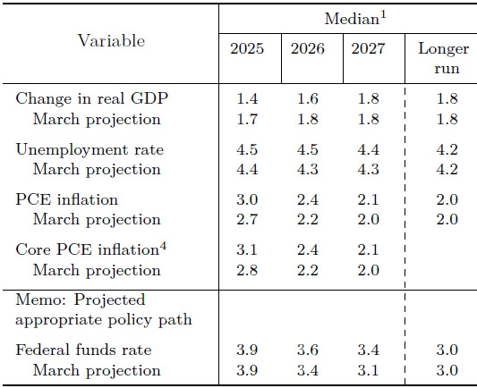
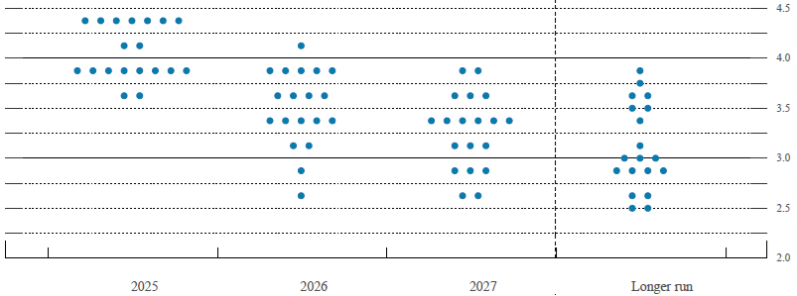
FOMC Meeting June 17 to 18
Next meeting 07/30/2025
06/18/2025
Federal Reserve Board - Federal Reserve issues FOMC statement
Fed Funds rate target range unchanged at 4.25% to 4.50%
Balance sheet reduction (QT) reduced from $60B/month to $40B/month, starting April
Summary of Economic Projections (S.E.P.) survey
  GDP growth rate lowered
  Unemployment rate slightly higher
  PCE inflation expected higher
  One 0.25% rate cut projected
”Surveys of households and businesses, however, report a decline in sentiment over recent months and elevated uncertainty about the economic outlook, largely reflecting trade policy concerns.”
S.E.P.
Dot Plot
Notes:
SEP = Summary of Economic Projections

Slide 4
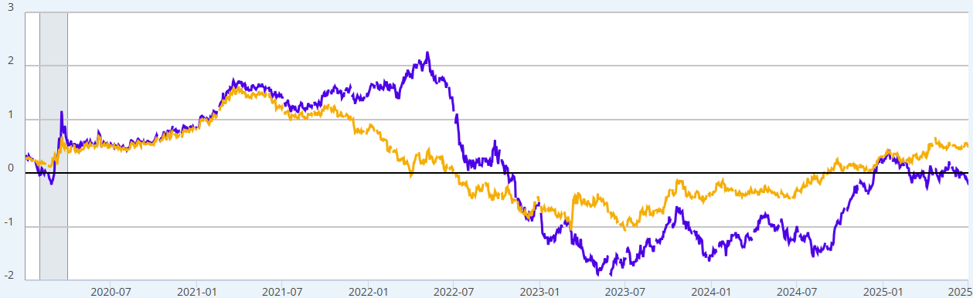
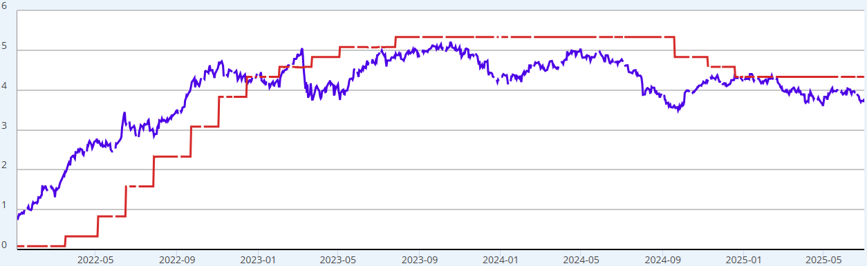
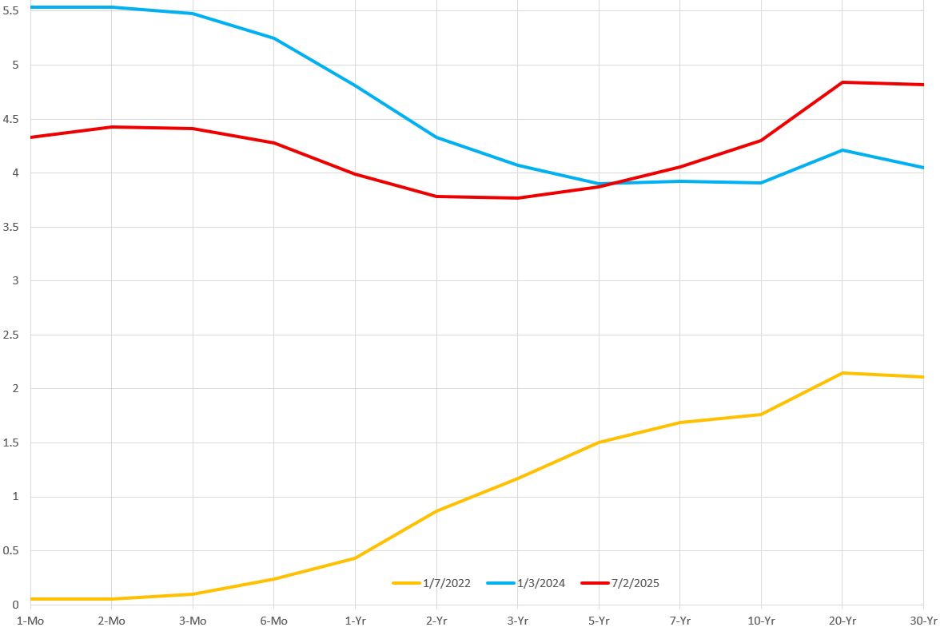
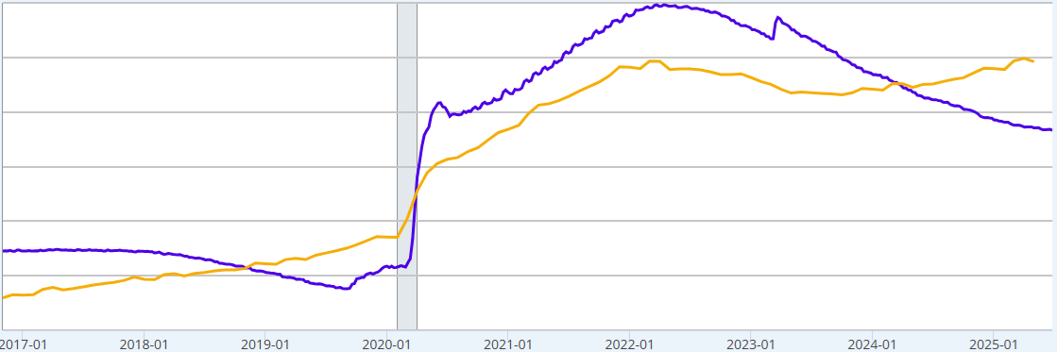
Interest Rates, Yield Curve, and QT
07/02/2025
Resource Center | U.S. Department of the Treasury
T10Y3M
T10Y2Y
DGS2
EFFR
Yield curve flirting with inversion
Market thinks Fed Fund Rate can be lowered
Interest rate by maturity
2025-06-05
Short term rates are driven by Monetary Policy
Long term rates reflect inflation expectation
and gov. financial condition
Quantitative Tightening (QT) reduces money supply and liquidity in economy
Reducing bond holding of $95B/month starting 9/1/2022
Reducing bond holding of $60B/month starting 6/1/2024
Reducing bond holding of $40B/month starting 4/1/2025
As of 06/25/2025, reduced 25.3% for target of 31.8%
$ 6.7 Trillion
$21.8 Trillion
WALCL
M2NS

Slide 5
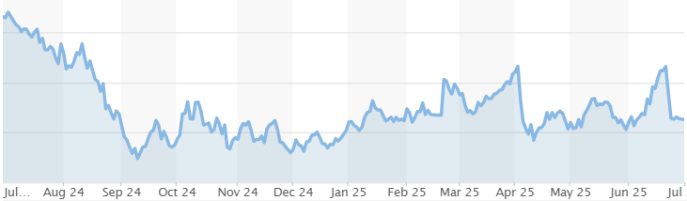
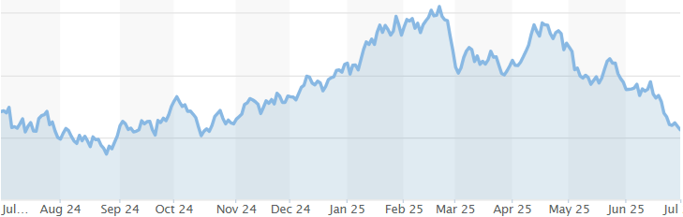
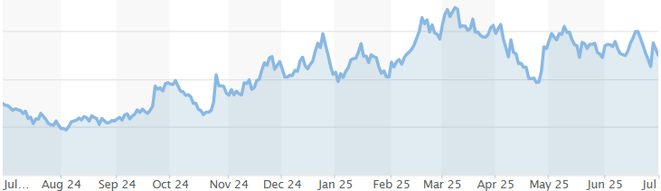
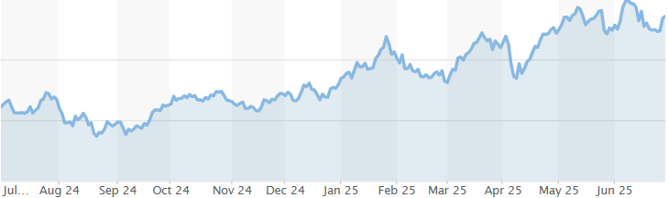
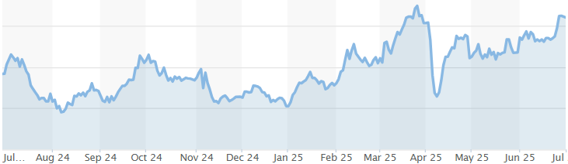
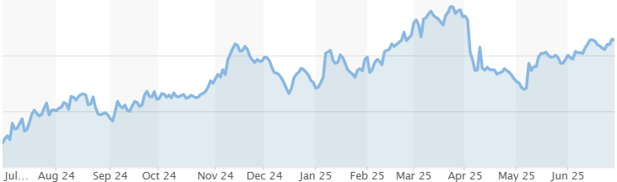
Commodity Futures
06/30/2025
https://www.marketwatch.com/investing/futures

Slide 6
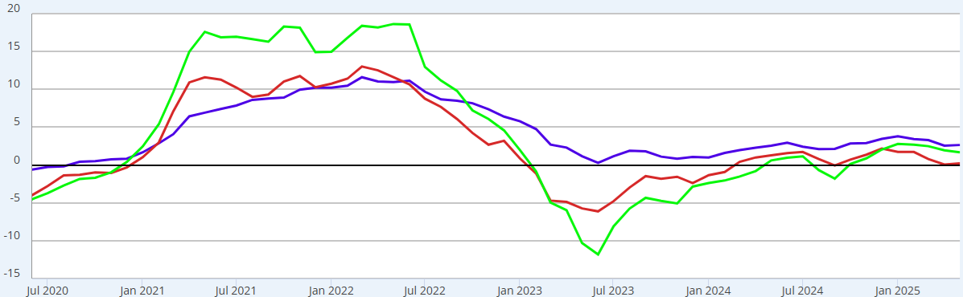
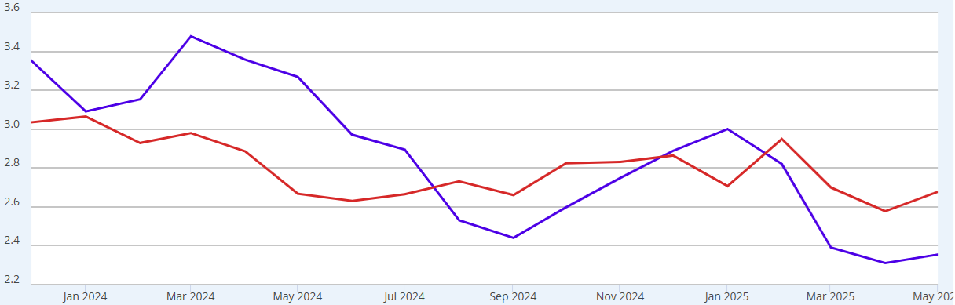

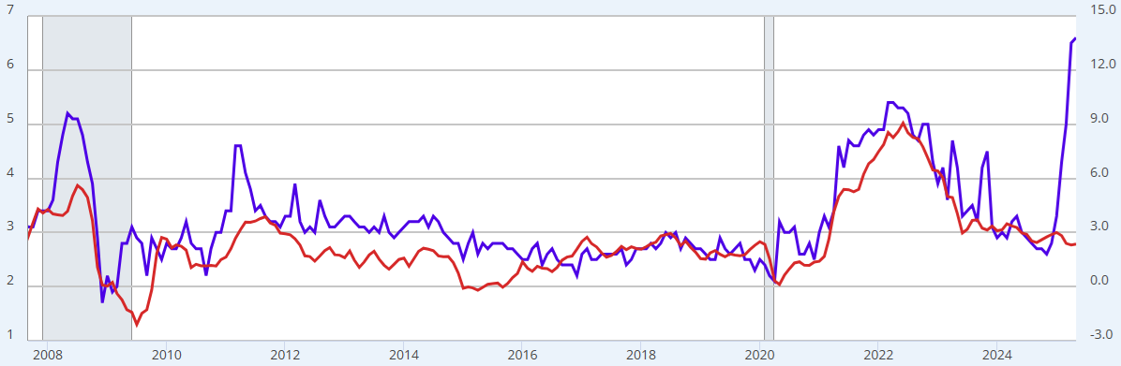
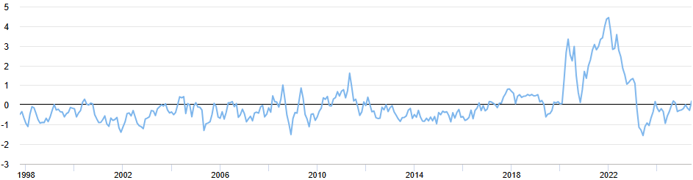
Inflation – PPI, CPI, PCE
06/29/2025
Waiting for the impact of tariffs
Waiting for the impact of tariffs
PPIFIS
IR
IQ
CPIAUCNS
PCEPILFE
Inflation expectation spiking up to 1981 level
June plummeted to 5%
MICH
CPIAUCNS
Tariffs can and do squeeze supply chains
Notes:
FOMC’s “Statement on Longer-Run Goals and Monetary Policy Strategy” clearly stated 2% Core PCE is its goal for long-term average inflation rate.

Slide 7
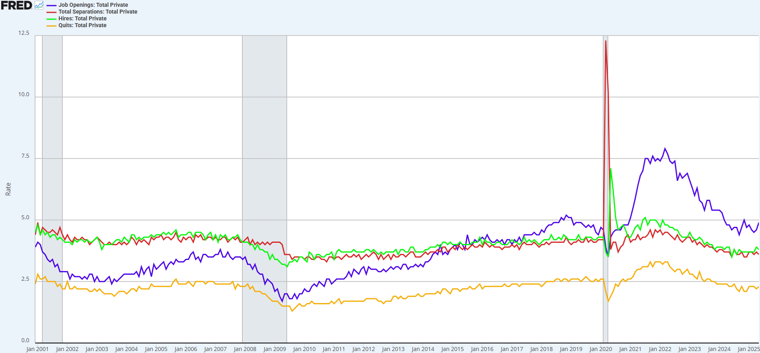
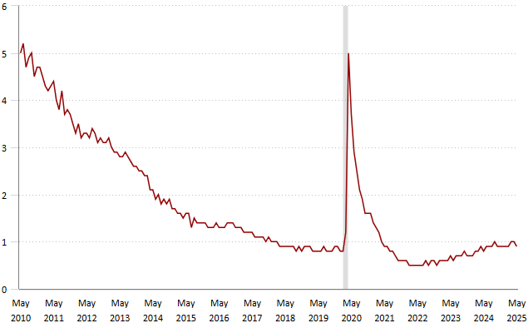
Jobs Openings and Labor Turnover Summary (JOLTS)
07/01/2025
https://www.bls.gov/news.release/jolts.nr0.htm
JTS1000JOR
JTS1000TSR
JTS1000HIR
JTS1000QUR
More Openings than unemployed.
Hires and Separations at 2013 level, labor market is lukewarm.
Quits indicates tightness of labor market. It normalized to 2016 level.
JOLTS
Notes:
https://fred.stlouisfed.org/series/IHLIDXNEWUS

Slide 8
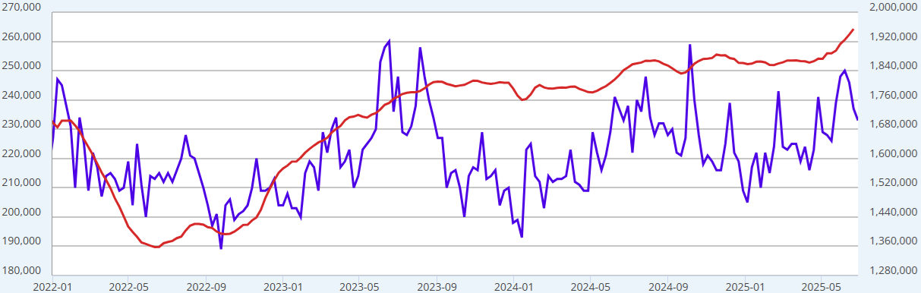
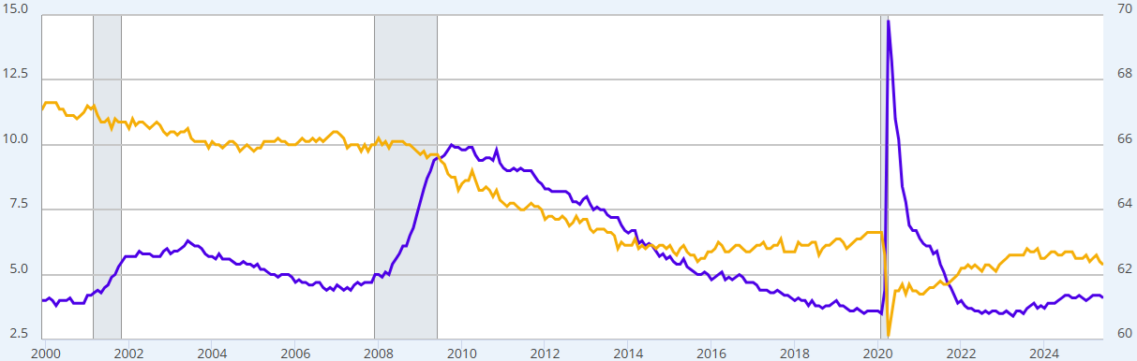

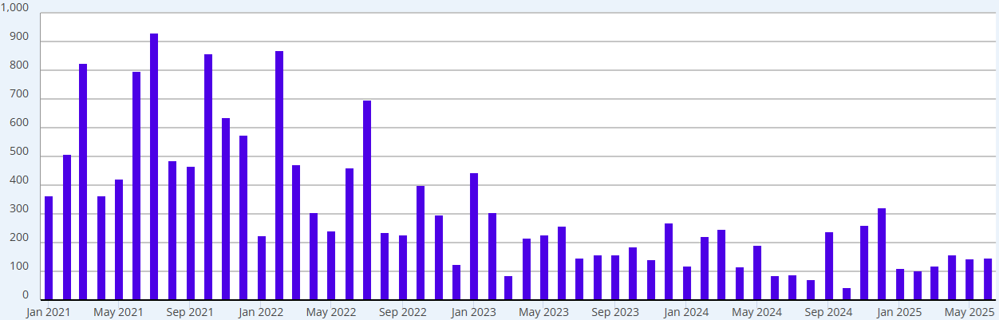
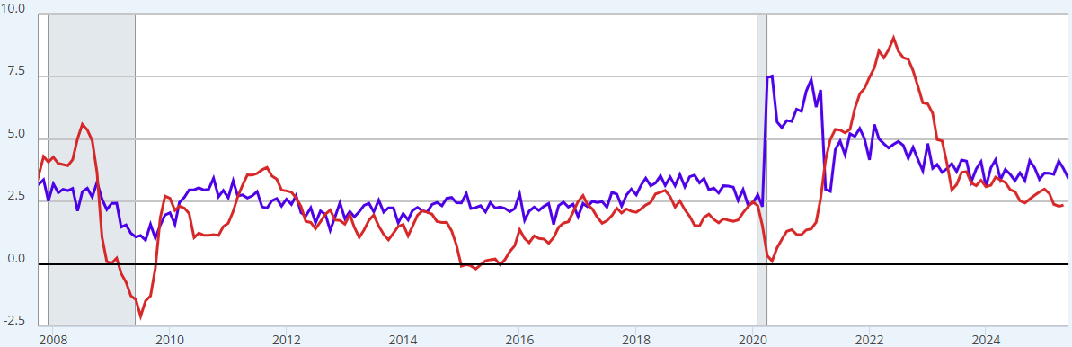
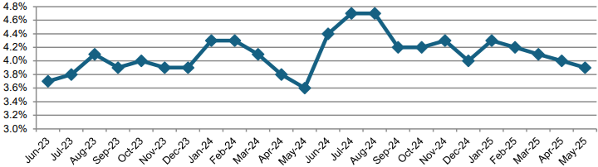
Employment and Wage Growth
07/03/2025
Next release 08/01/2025
https://www.atlantafed.org/chcs/wage-growth-tracker
ICSA
CC4WSA
UNRATE
CIVPART
Unemployment rate near historical low level.
Labor Participation Rate stable.
Both are at historical low levels
07/03/2025
PAYEMS
Income level healthy.
EDD
06/20/2025
CES0500000003 * AWHAETP
CPIAUCNS
Notes:
Employment data is one month behind, as it is released on Friday of 1st week each month.

Slide 9
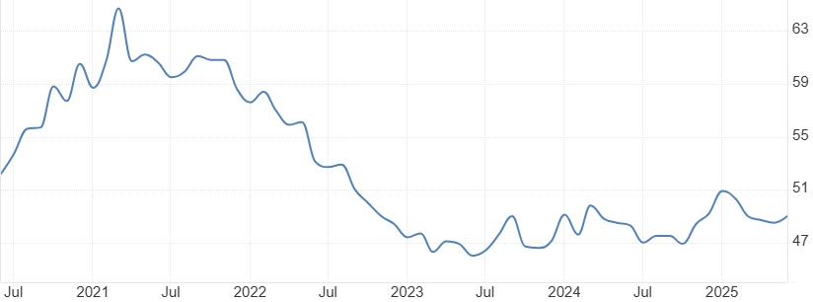
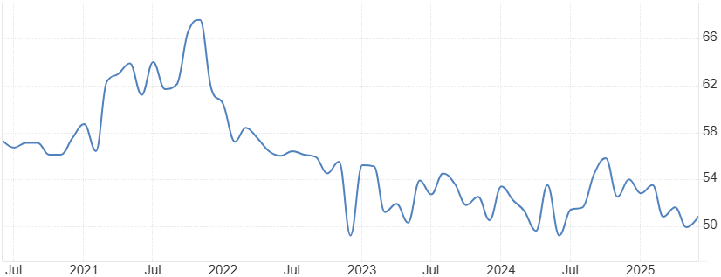
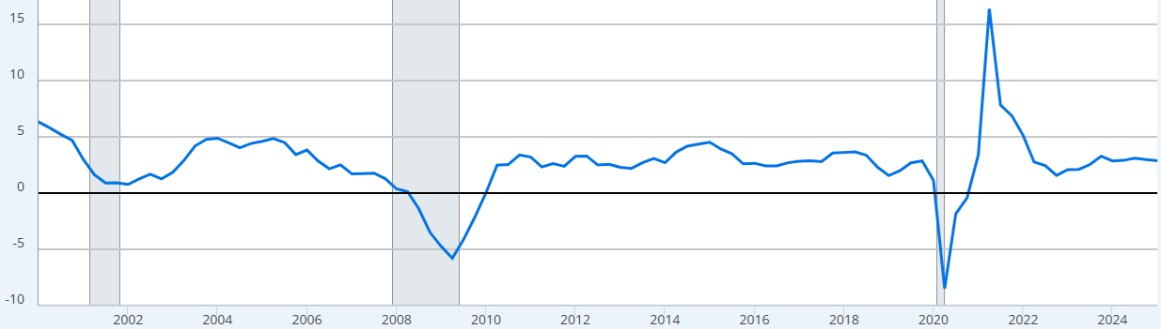
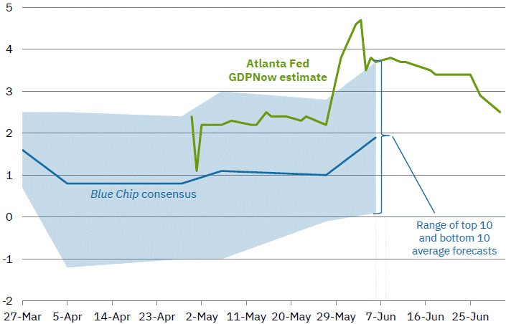
ISM, PDP, and GDPNow
07/03/2025
https://www.atlantafed.org/cqer/research/gdpnow
2025-07-01
2025-07-03
At 49, contracting
At 50.8, OK
LB0000031Q020SBEA
Q1/2025
“Private Domestic Final Purchases (PDFP), which excludes inventory investment, government spending and net exports, and usually sends a clearer signal on underlying demand” – Jerome Powell
06/26/2025
Notes:
Weekly Economic Index - Dallasfed.org

Slide 10
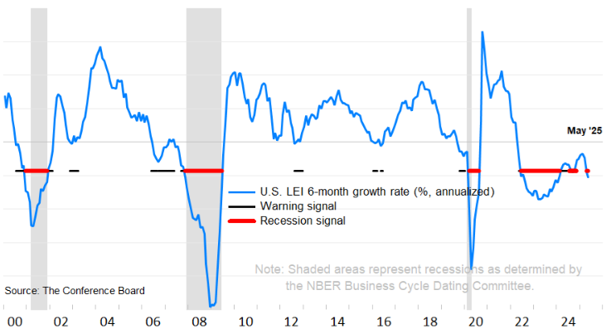
Leading Economic Indicator
Next release 07/21/2025
06/20/2025
US Leading Indicators (conference-board.org)
The LEI’s negative six-month growth rate and contraction in the diffusion index over the past six months triggered the recession signal in May

Slide 11
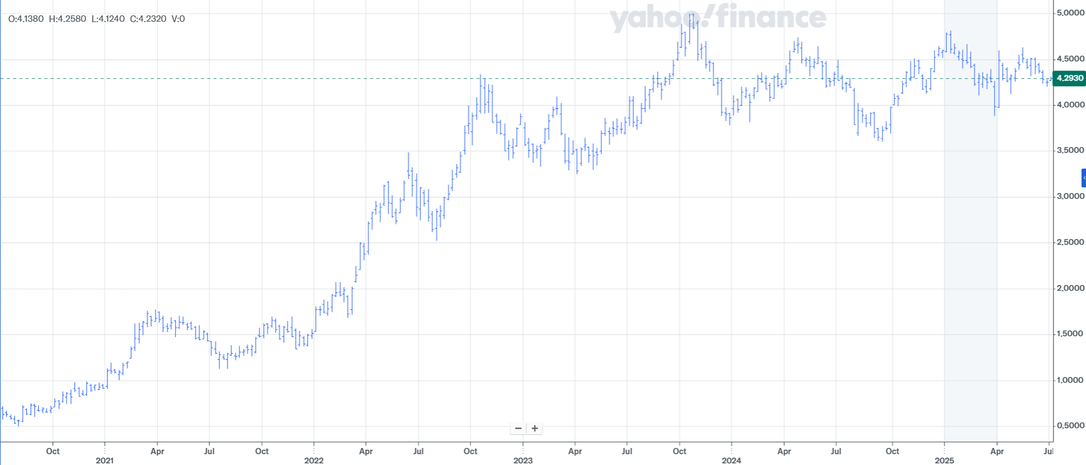
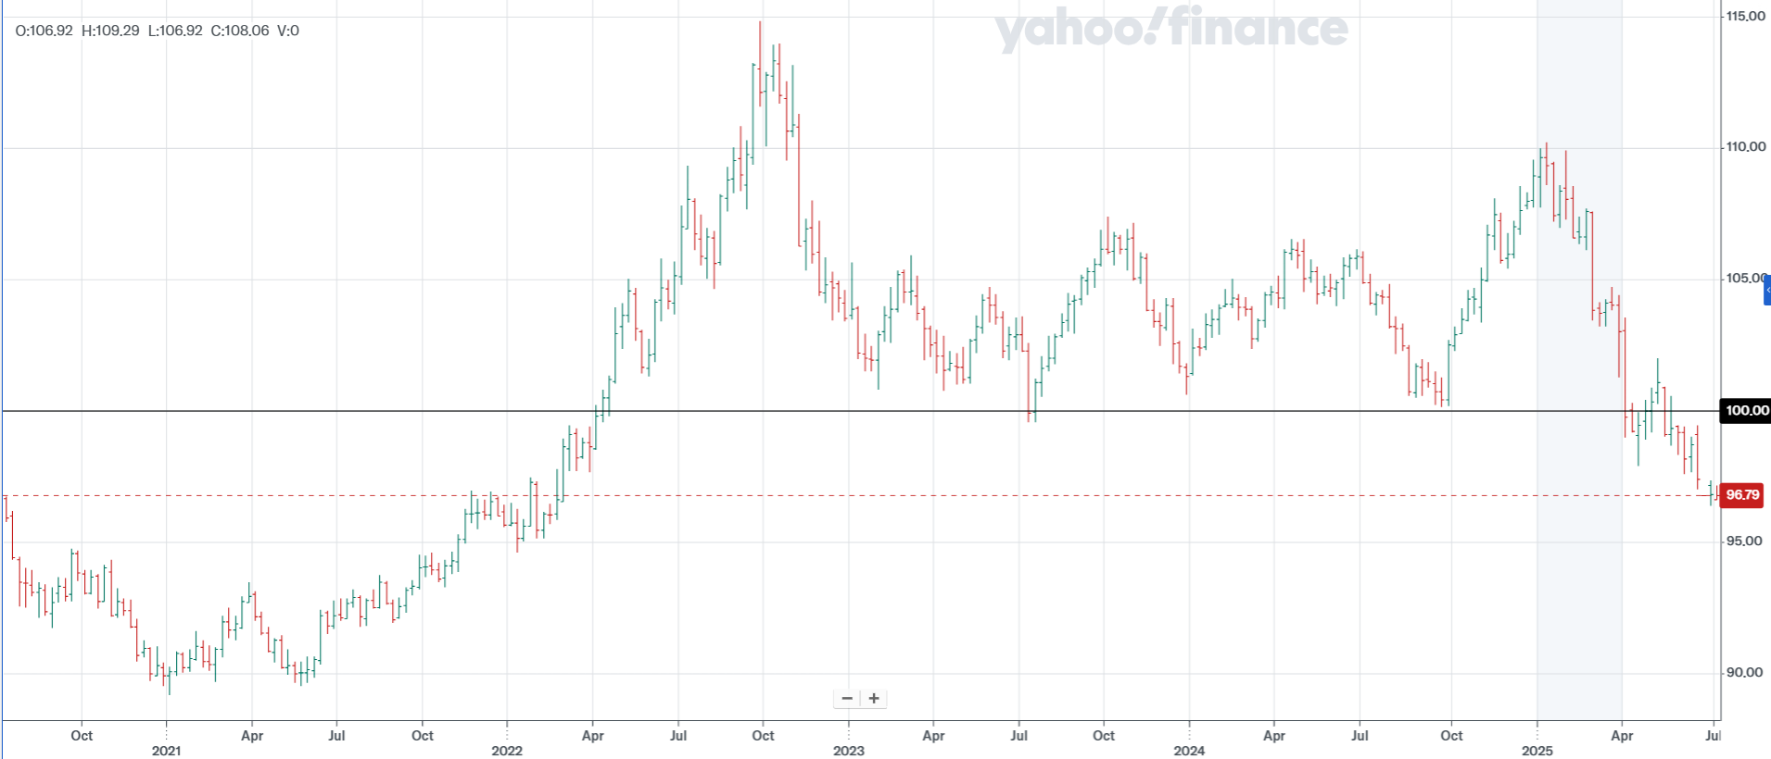
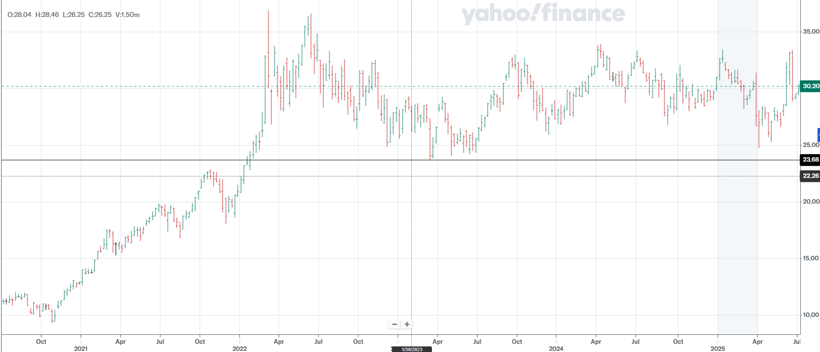
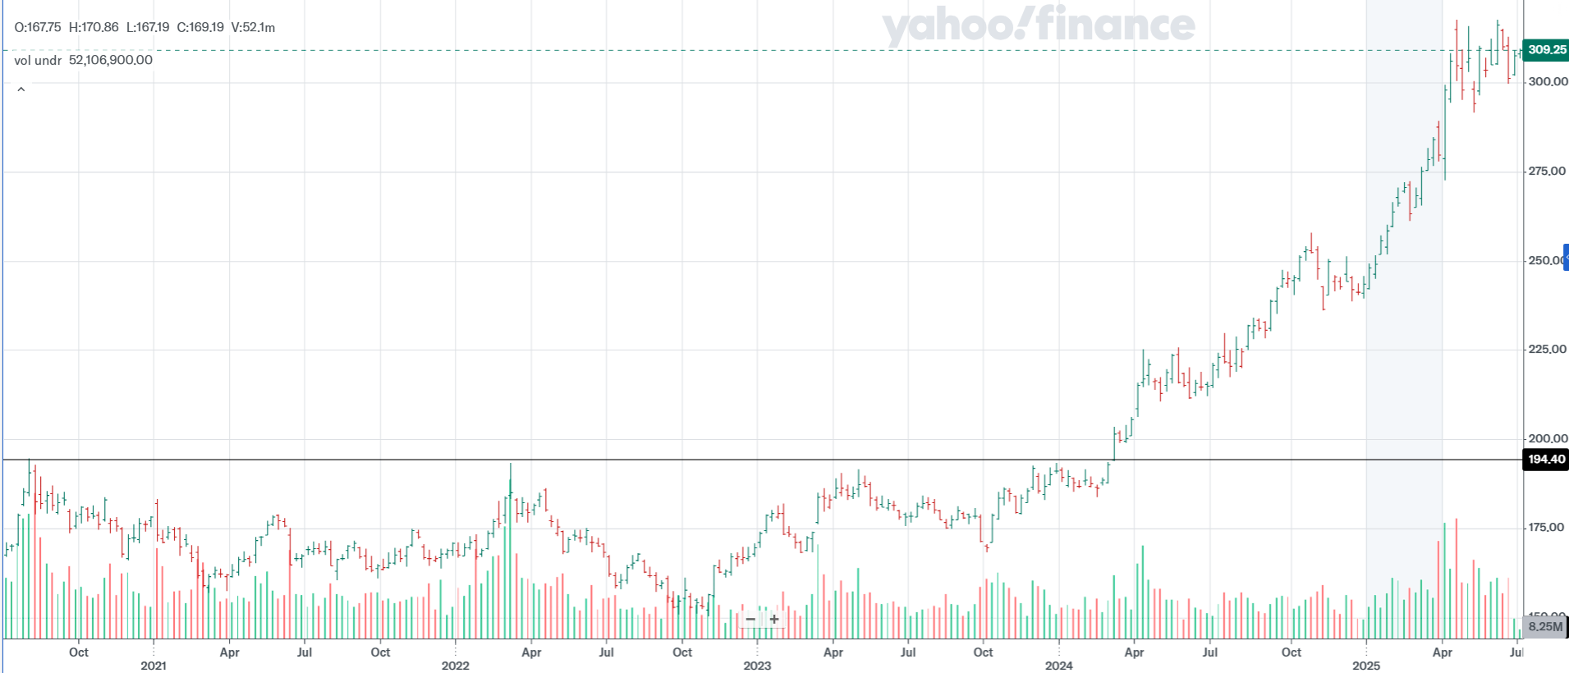
Selected Market Indicators - 5-Year View
07/02/2025
Range bound
relative weak
Range bound
consolidating

Slide 12
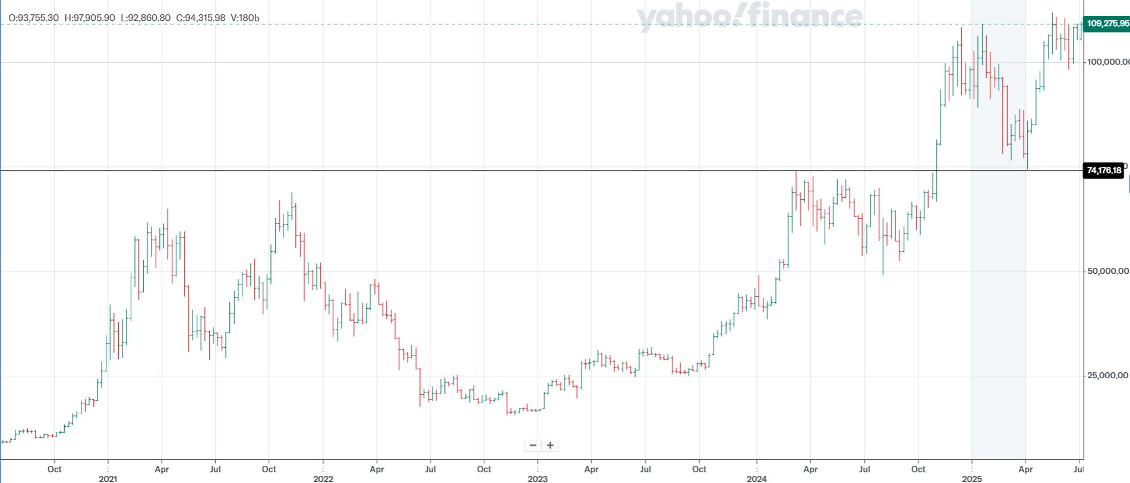
Bitcoin
07/02/2025
Spot Bitcoin ETFs Are Here. Should You Invest? | Morningstar
There are 9,650 crypto listed on yahoo.com
Collapse of $32B FTX in Nov 2022 was good entry point
Binance admitted guilt to federal charges and fined $4B in Nov 2023
SEC approved spot-price Bitcoin ETFs on Jan 10th, 2024
SEC approved spot-price Ethereum ETFs on July 23rd, 2024
Trump has included Bitcoin in his strategic reserve on March 2, 2025
Notes:
CBBTCUSD

Slide 13
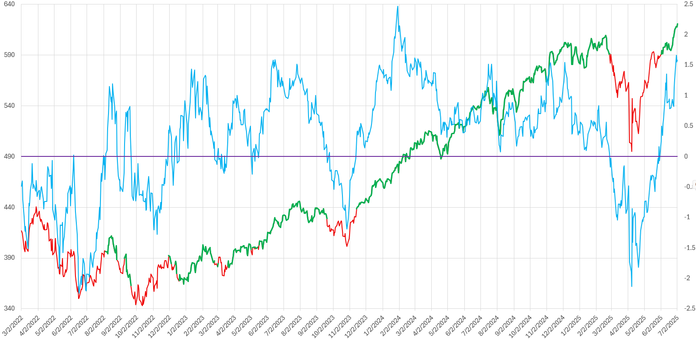
Simple 3-Month Price Momentum
07/02/2025
https://www.advisorperspectives.com/commentaries/2020/06/12/the-math-is-on-investors-side
3-Month Price Change / 5-Year Standard Deviation
Notes:
Note: using 0-line as threshold basically just shows the sign of 3-month rate of change (momentum). That is not a good timer in backtest.
An over-bought/over-sold indicator like this doesn’t do good job of telling you when to sell, but does a better job of telling you when to buy.

Slide 14
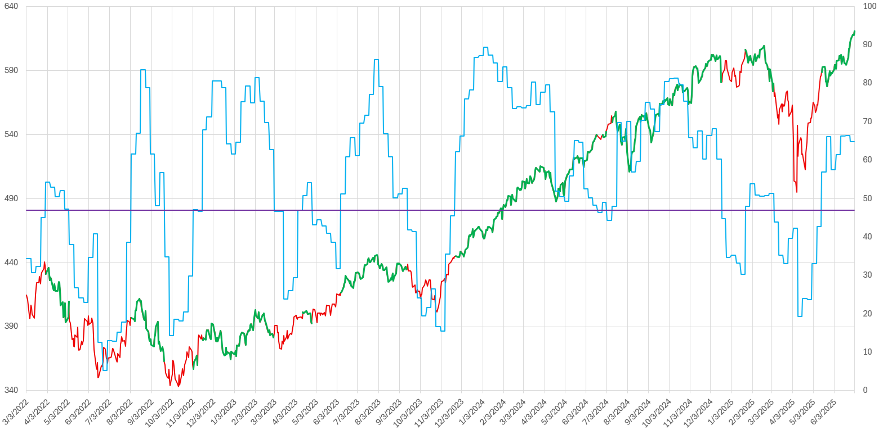
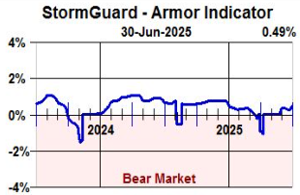
Delta MSI
07/02/2025
TEAM - Delta Investment Management (deltaim.com)

Slide 15
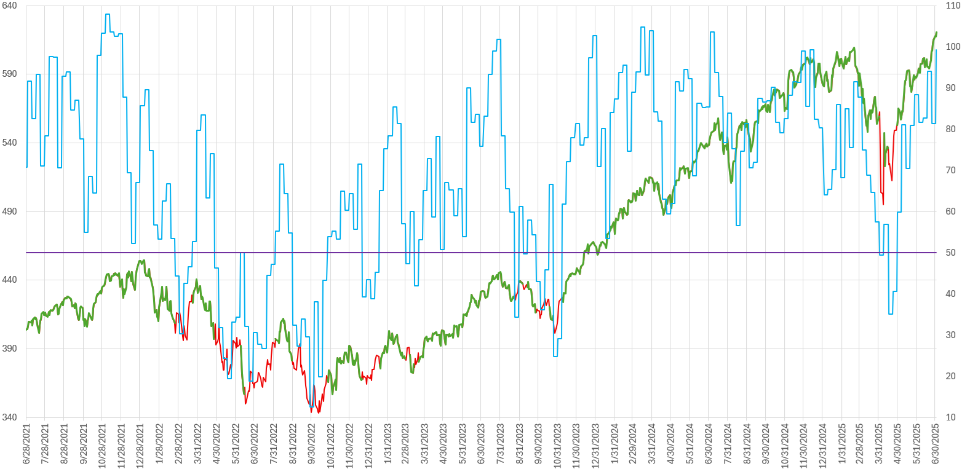

NAAIM Exposure Index
07/03/2025
https://www.naaim.org/programs/naaim-exposure-index/
Threshold at 50
Notes:
A sentiment indicator of professionals. It has not been doing well in 2022.

Slide 16
Top 20 Winners - June
07/02/2025
Russell 1000
Non-Leveraged
Leveraged
Note: R1000 issues filtered by price-volume of $10M on last trading day. $1M for ETFs.

Slide 17
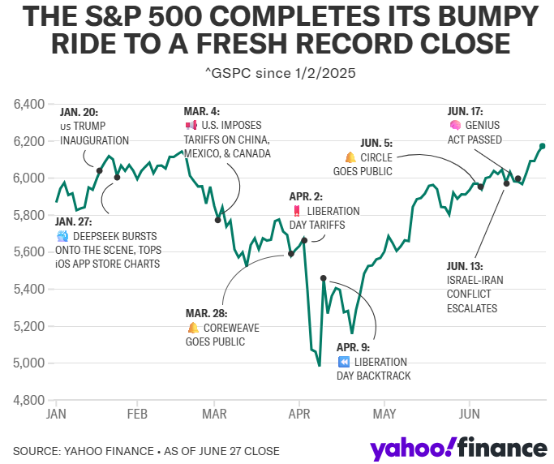
Buy The Dip
06/29/2025
A crucial jobs report meets a stock market at all-time highs: What to know this week

Slide 18
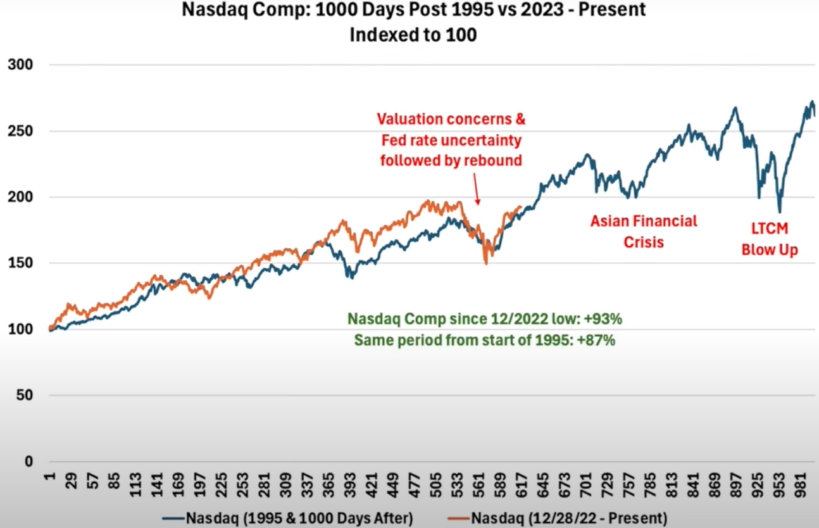
NASDAQ Eerily Tracking Its 1990s Bull Run
06/15/2025
https://youtu.be/Cn8aRNqe-8M?si=Yj0VXLtKGyWPuu6R (DataTrek Research)

Slide 19
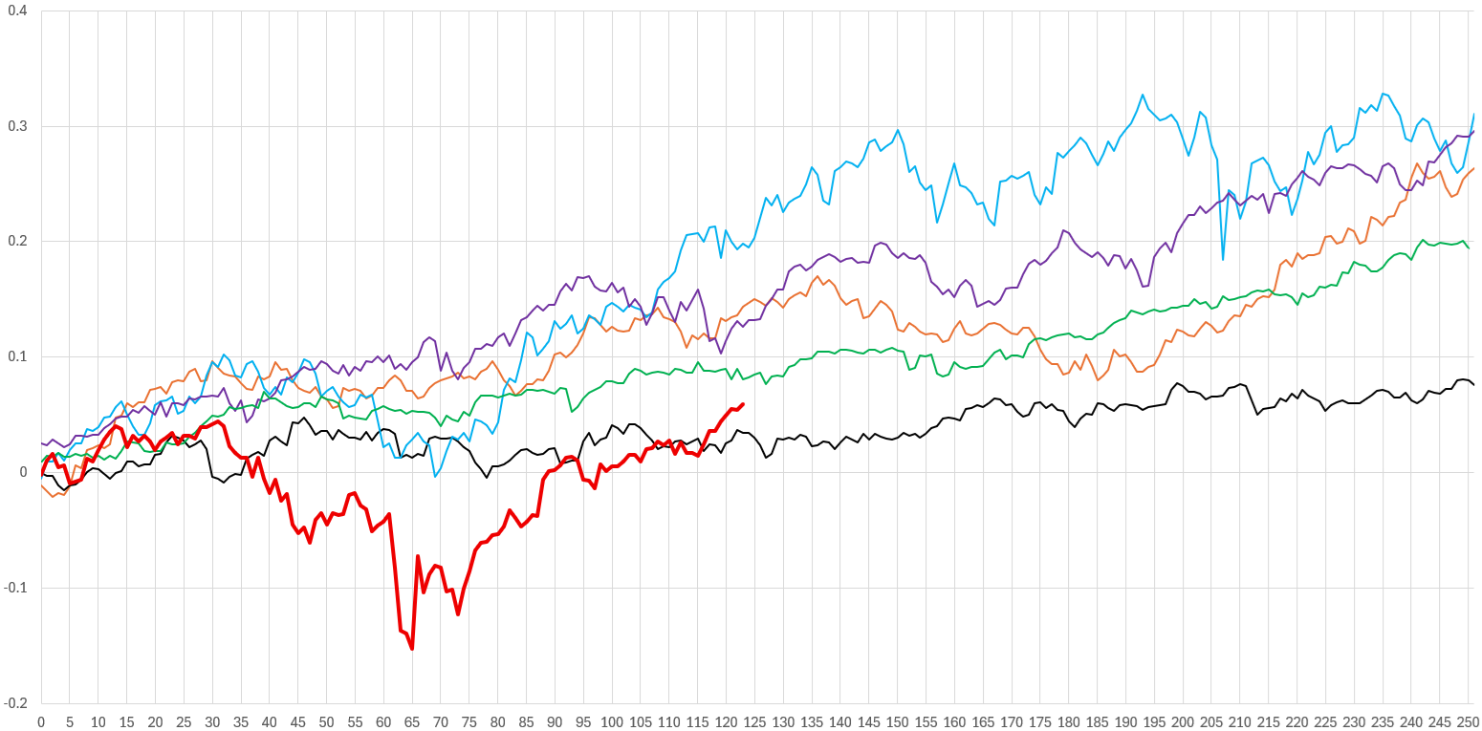
First-year Presidential Cycle – Better Years
07/02/2025

Slide 20
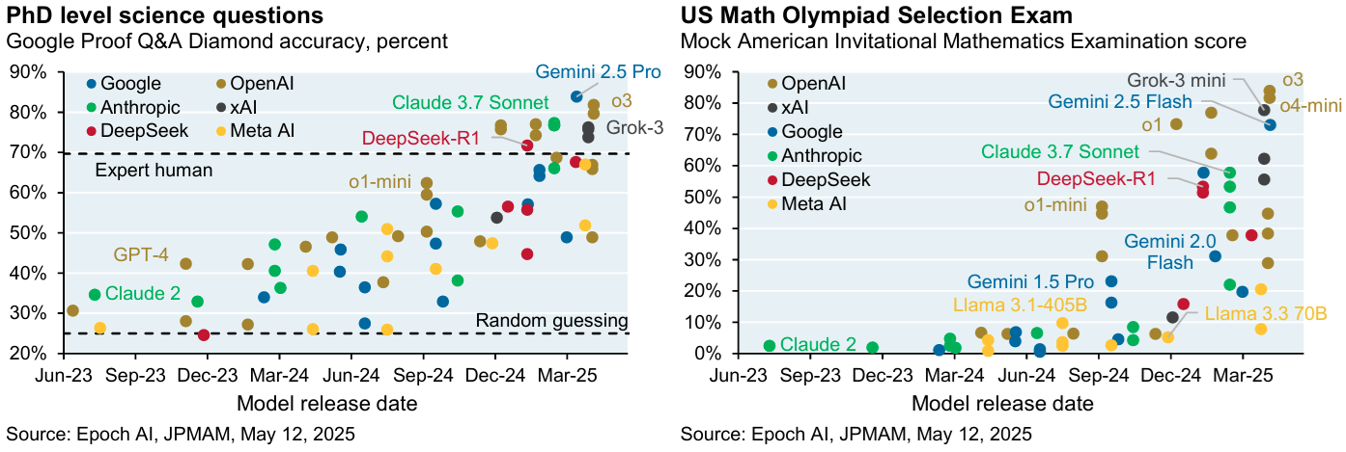
State of AI (LLM)
Eye on the Market

Slide 21

Q & A
“Markets price the future; economic reports tell the past” – Ken Fisher
“Things that have never happened before happen all the time” – Scott Sagan
Reminder: Information presented are backward-looking for entertainment only.
Convention:
Relevant URLs are inserted below page title and may be embedded in the page. FRED series IDs are displayed on page. Date of last update is on right side of title bar. Some charts may have their own last update date.
Notes:
Please send us any question, feedback, suggestion, and constructive criticism.

